Slide 1
Practical Knowledge Graph Example
Protege, Stardog and Peeps

Slide 2
Today’s exercise
Look at a simple ontology for information about people and their relations in Protégé
Look at some instance data in Protégé
Run the DL and rule reasoner in Protégé
Load the ontology and data into Stardog
Browse and query the resulting knowledge graph in Stardog

Slide 3
Preliminaries
On your own computer (Windows, Mac, Linux)
Download and install Protégé
Download, install and configure the latest edition of Stardog
Clone the 691 peeps repository

Slide 4
Peeps files
The peeps repo has five files
README.md
catalog-v001.xml – protégé config file
load_peeps.sh – bash script to load peeps into stardog
mypeeps.ttl – data encoded using peeps ontology
peeps.ttl – the peeps ontology
prefixes.ttl – list of prefixes, used by stardog’s query component

Slide 5
Separate ontology and data?
An ontology is a knowledge graph schema
peeps:Man owl:disjointWith peeps:Woman .
We talk about populating it with instance data
:janeDoe a peeps:Woman; foaf:givenName “Jane” .
Good practice for real applications is to keep the ontology and data separate
i.e., in different files
Hence, peeps.ttl and mypeeps.ttl

Slide 6
Why separate ontology and data?
It really depends on the usecase
Some facts are part of an ontology if they’re important, unchanging knowledge
Maybe the ontology is a one-off, and will never be used with any other data
Maybe you added data while developing the ontology for testing and debugging
But many ontologies are intended for reuse or to represent datasets that change frequently

Slide 7
Namespaces
Promoting reuse also entails giving the ontology and a knowledge graph that uses it with data different namespaces
Namespace = uri = unique identifier
Example
http://dbpedia.org/resource/
http://dbpedia.org/ontology/
BTW, lookup prefixes at http://prefix.cc
Ideally, the uris are ones you control and no one else will use

Slide 8
Namespace best practice
Ideally, the namespace should resolve to a file containing the ontology or data
Maybe not the data if it’s big or proprietary
Enables other ontologies to import and use yours just from its URI
If you don’t control a long-lived URI …
You might use a file on github
You might use purl to create a “permanent url” that redirects to the current location

Slide 9
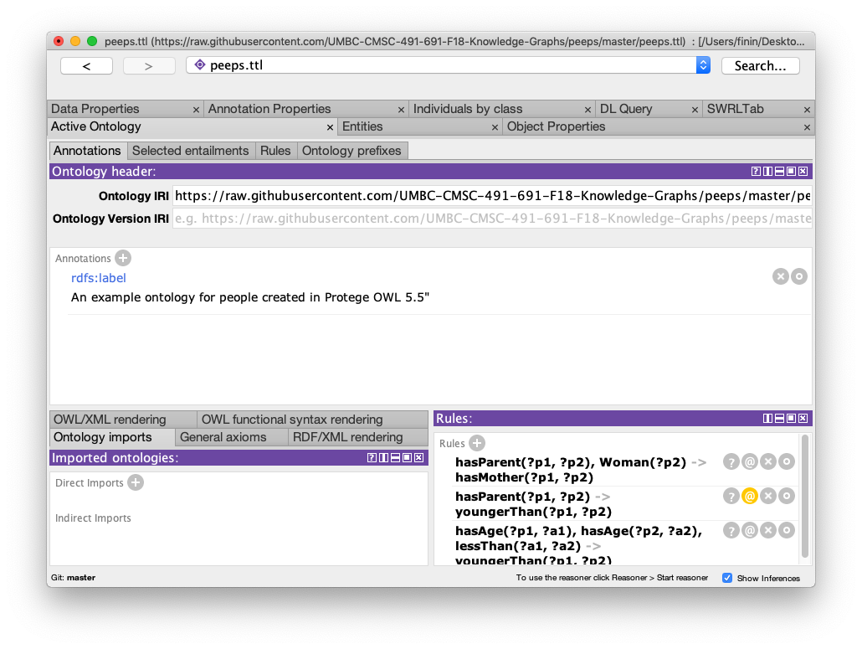
Peeps.ttl in Protégé

Slide 10
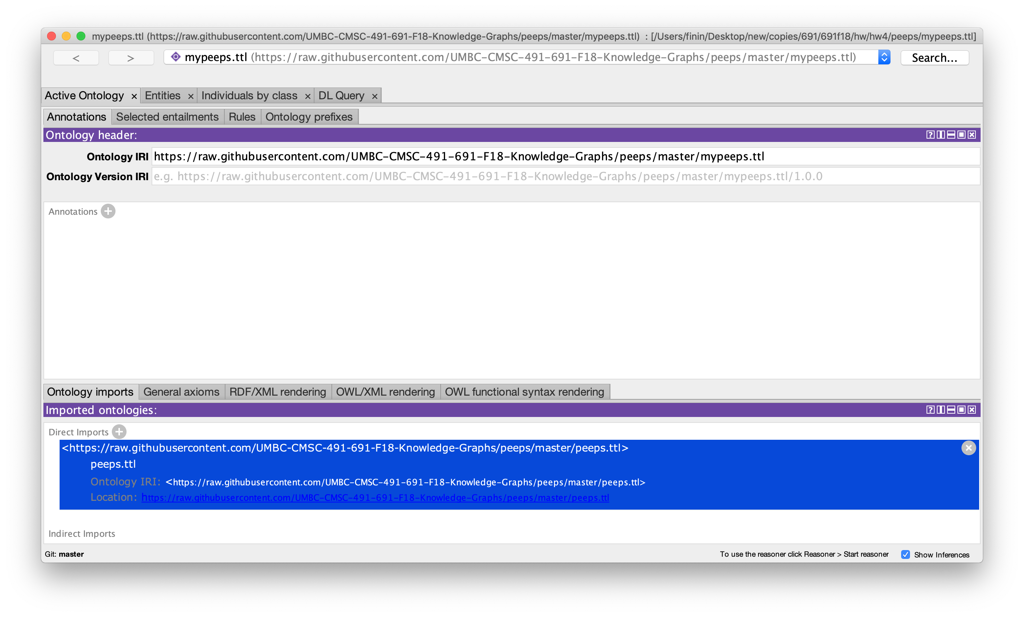
Mypeeps.ttl

Slide 11
When to import an ontology
In Protégé, we import an ontology if we want a reasoner to understand its vocabulary
It does not add the ontology to the file that will be saved
Plus: the knowledge may be important or essential in testing
Minus: big ontologies may add a lot of useless data
Here mypeeps.ttl imports peeps, but not foaf or schema

Slide 12
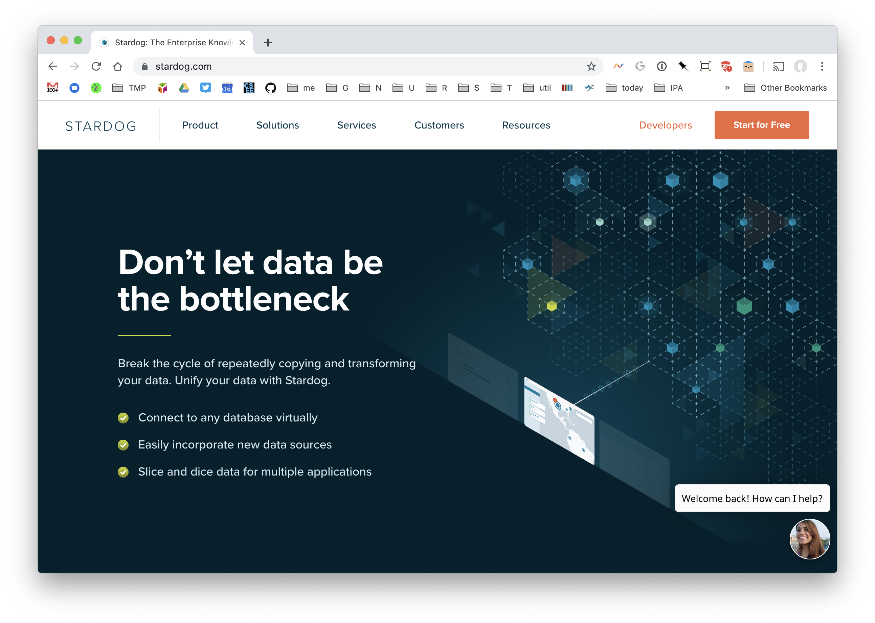
Stardog Knowledge Graph Platform
https://stardog.com/

Slide 13
Stardog Graph Platform
Stardog is easy to install and use, but rich in features
It has a separate Interface app, good command-line tools and a Java API
We’ll look at how to
Load the peeps example files
Browse the results
Query the graph via the Web console

Slide 14
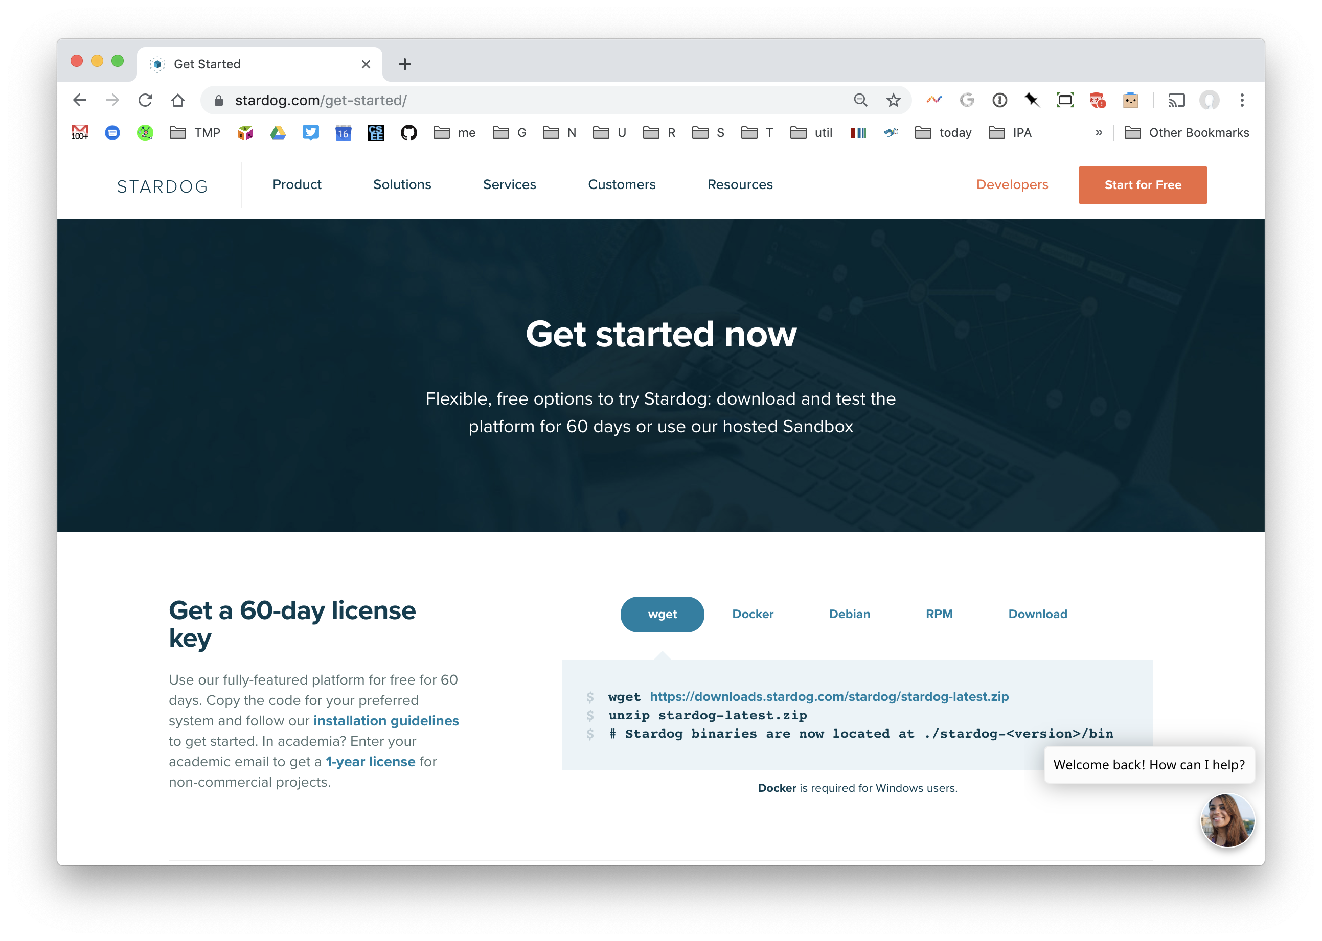
Downloading
Download & install Stardog and the Studio interface app
When you first launch Stardog, it will ask you for your email address
You will then get an email message with an attached license file to put in your Stardog directory
If you provide a .edu address, you’ll get a one-year license
Otherwise you’ll get a 60 day one

Slide 15
Start Stardog
This command will start Stardog listening to its default port (5820) and disable security
stardog-admin server start --disable-security
Enter the URL http://localhost:5820 to access the Web console
Use admin for both the user and password

Slide 16
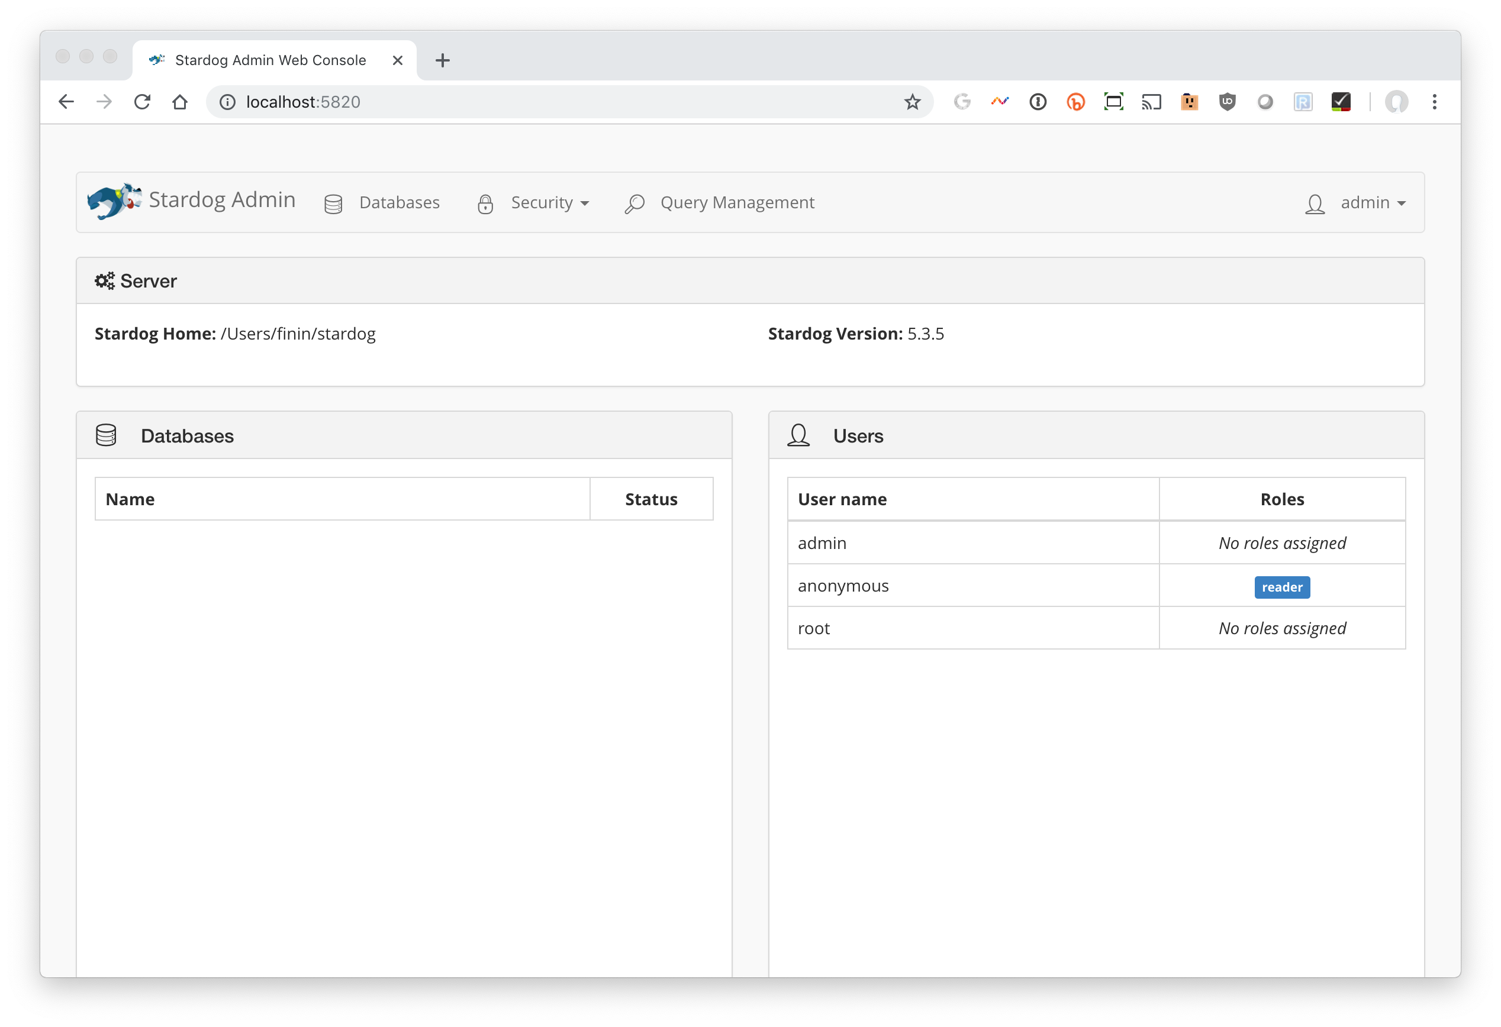

Slide 17
Stardog script
load_peeps.sh is a bash script for loading the peeps data and ontology
Use variations for other systems or shells
Once loaded go to http://localhost:5820/ to use Stardog’s web interface
Notes:
B

Slide 18
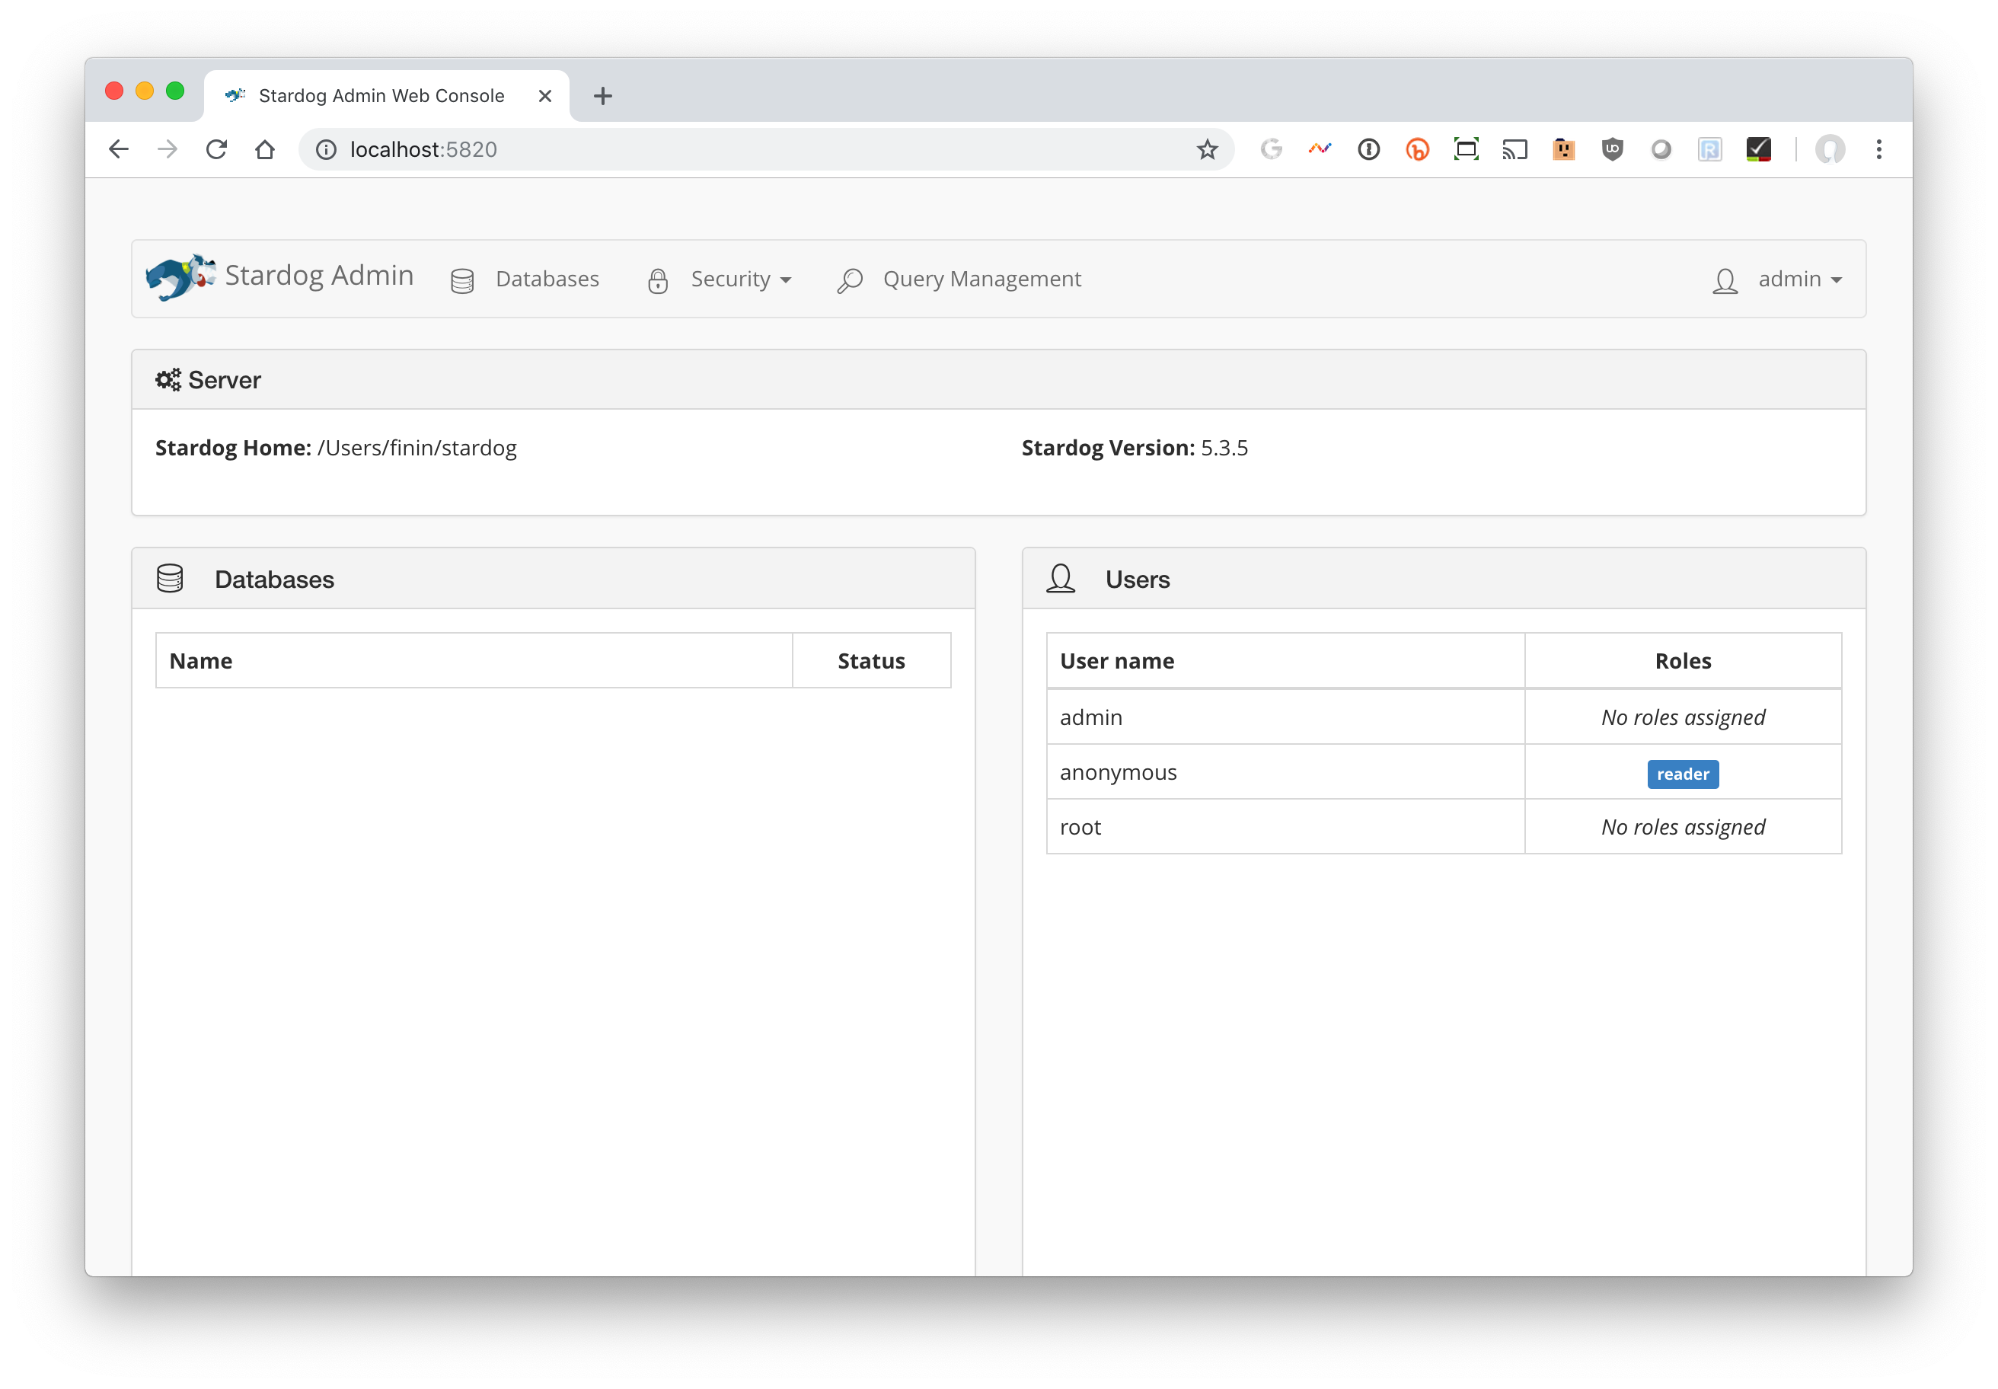
Stardog’s web interface

Slide 19
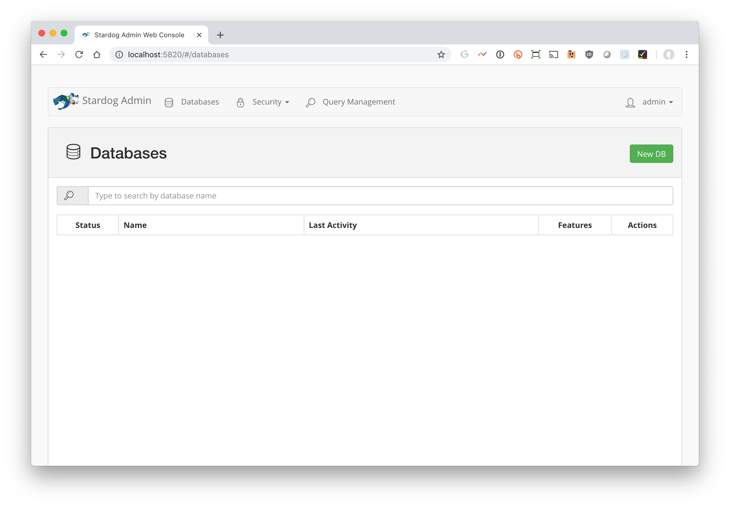
Create a database

Slide 20
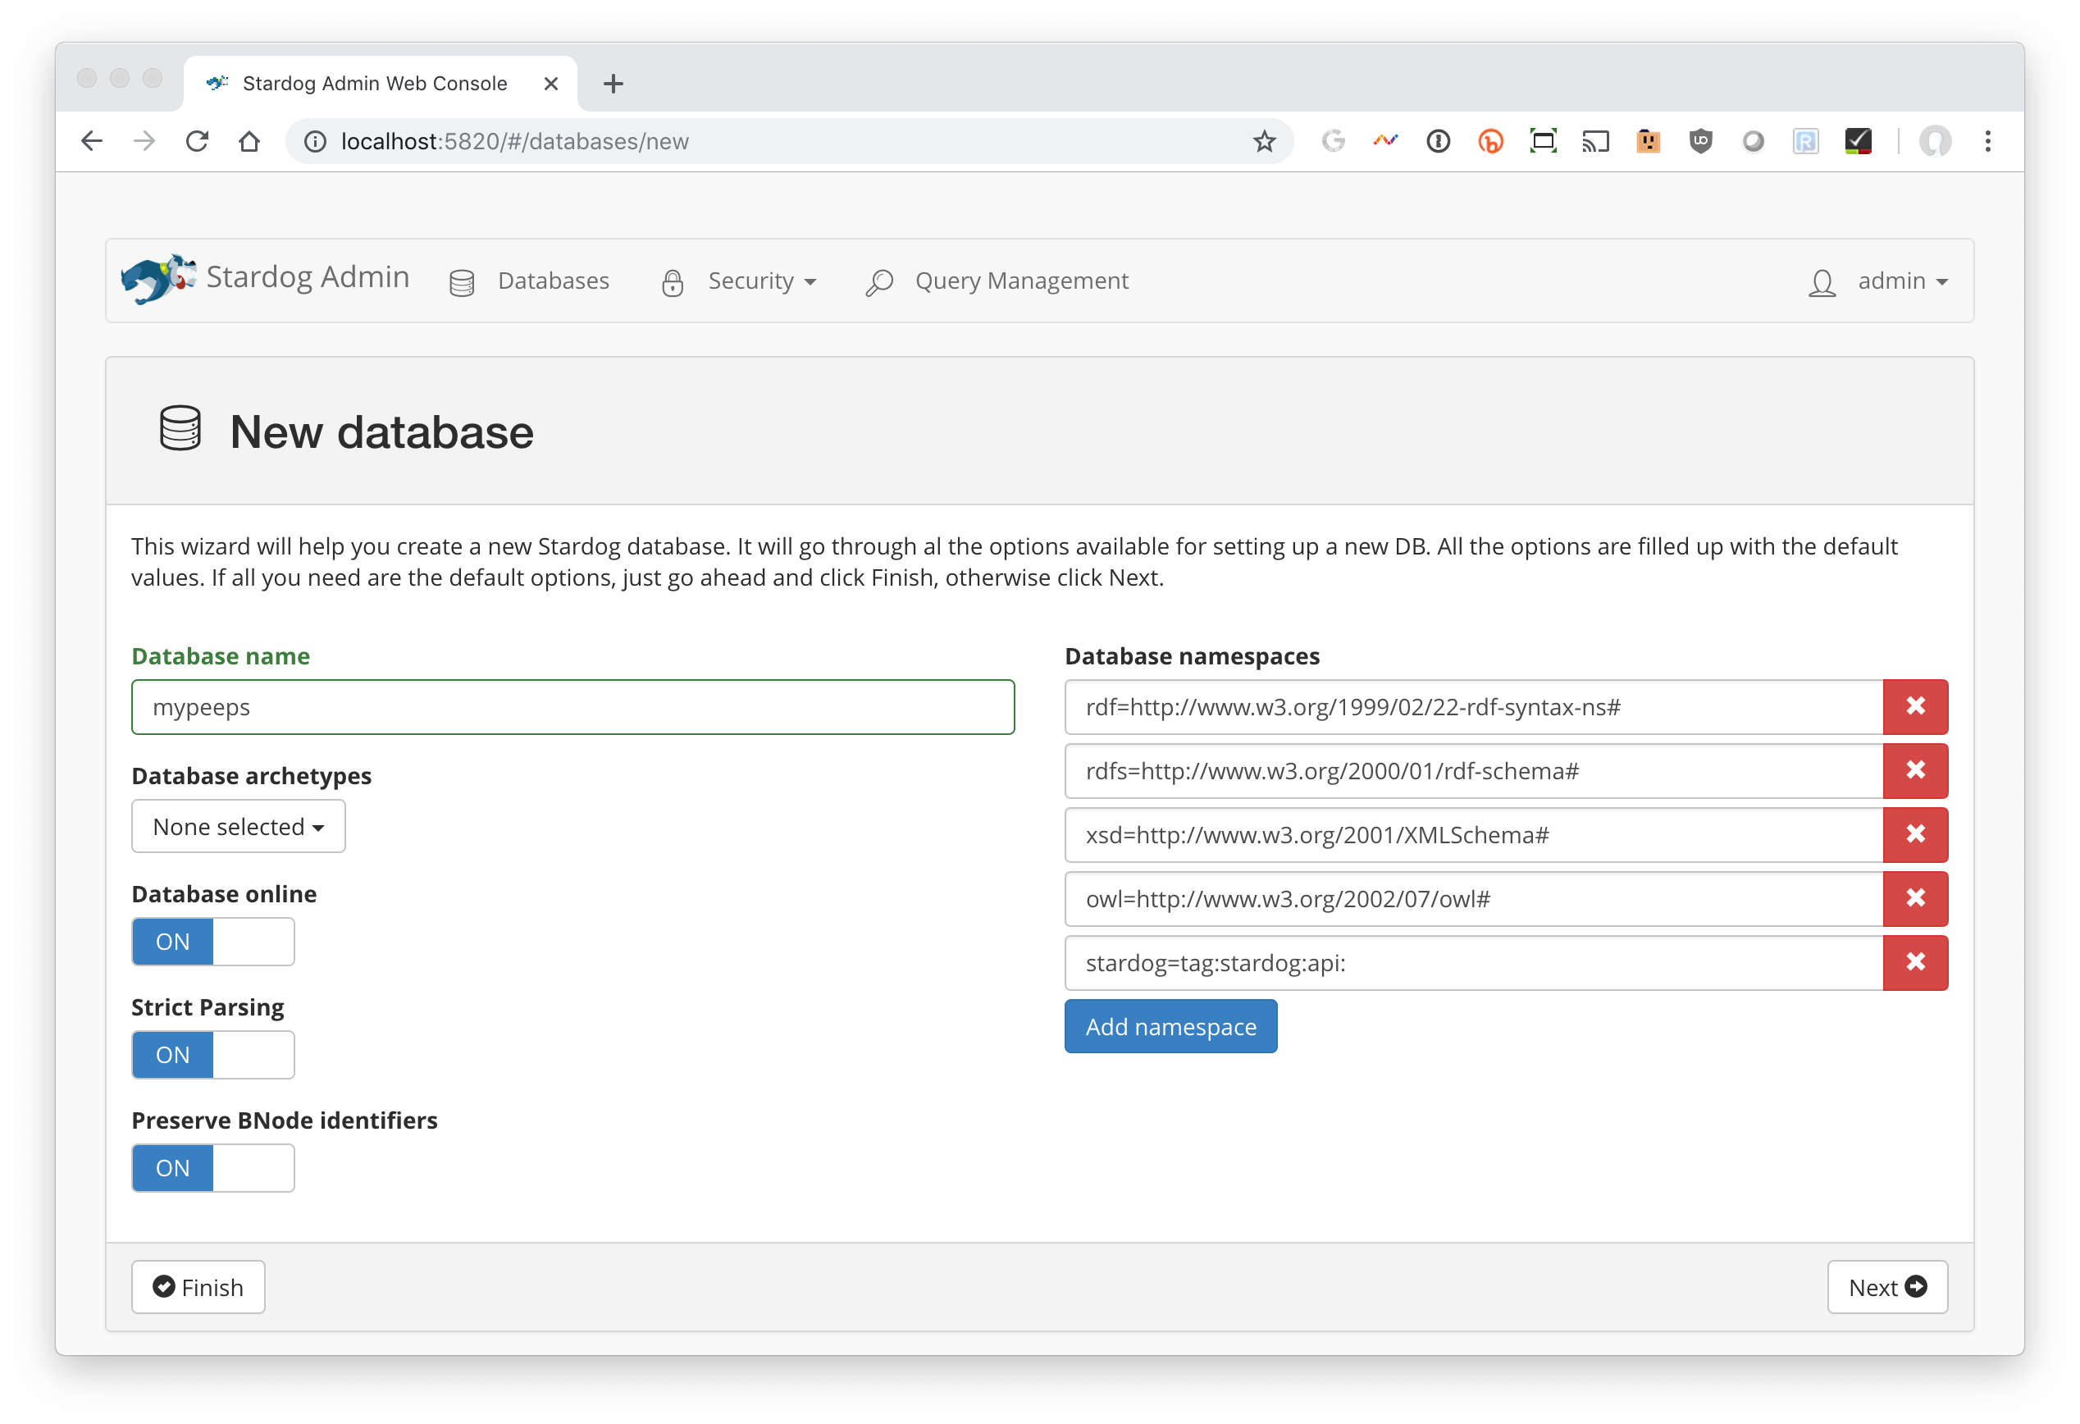
Name it mypeeps and accept the defaults

Slide 21
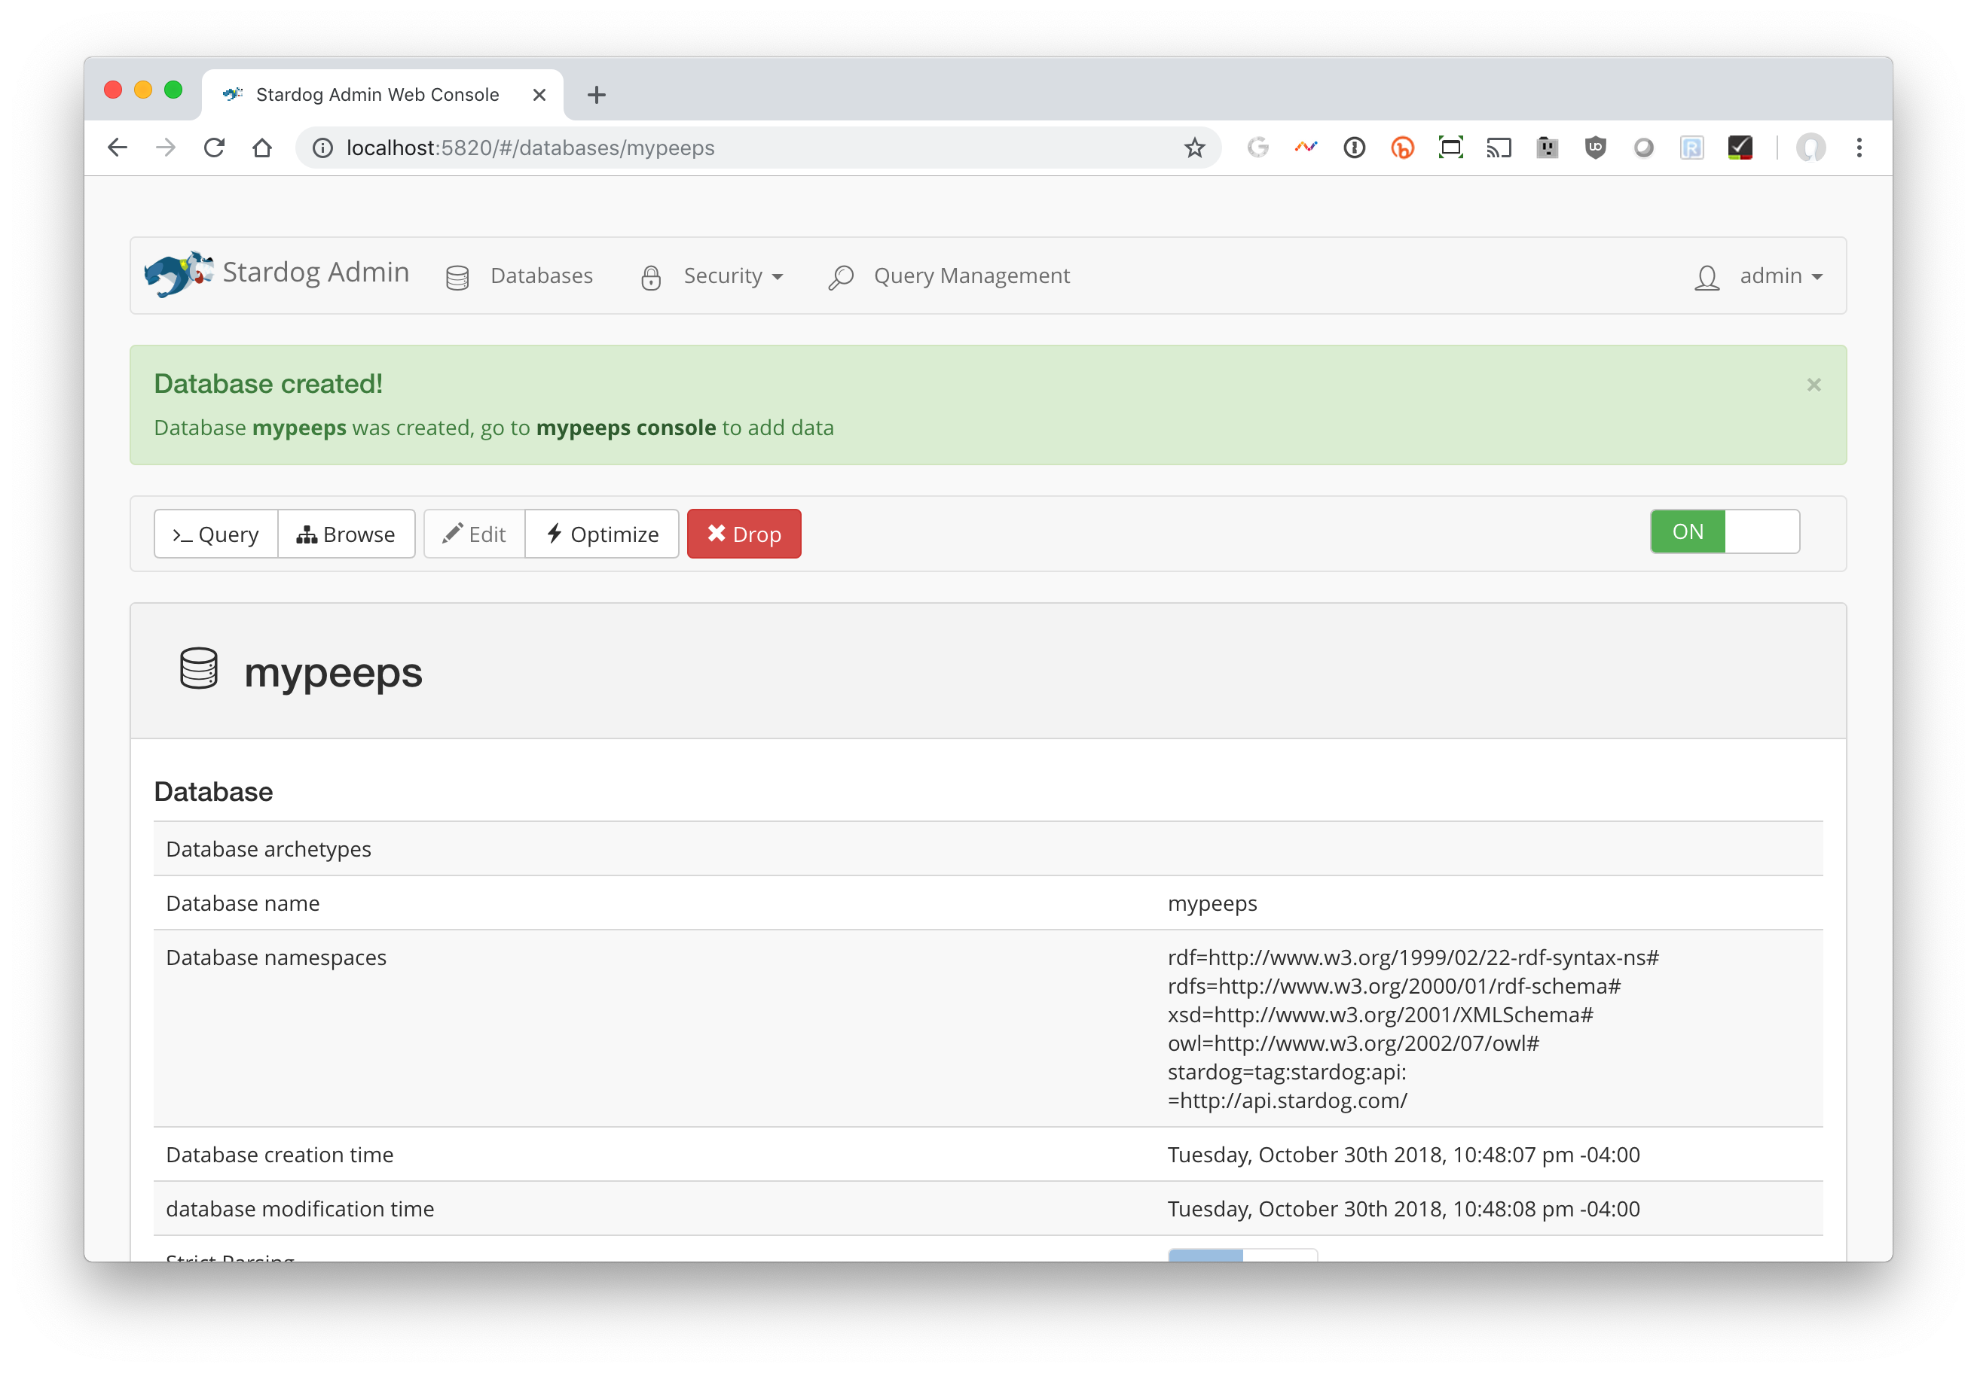

Slide 22
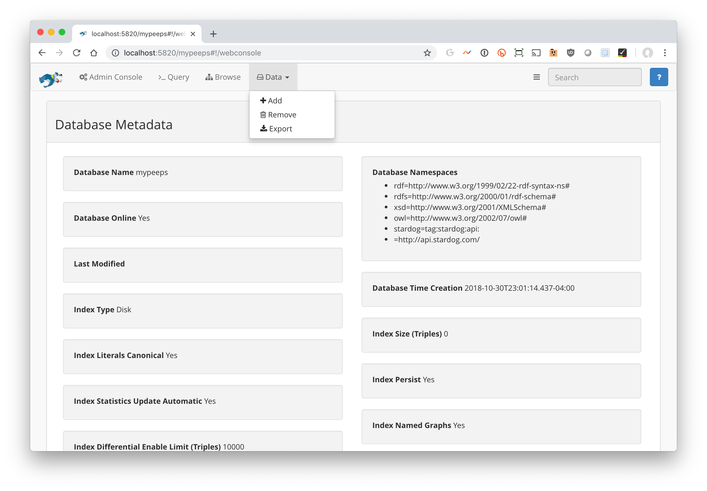
Click on data and select +Add
Add the files
peeps.ttl
mypeeps.ttl

Slide 23
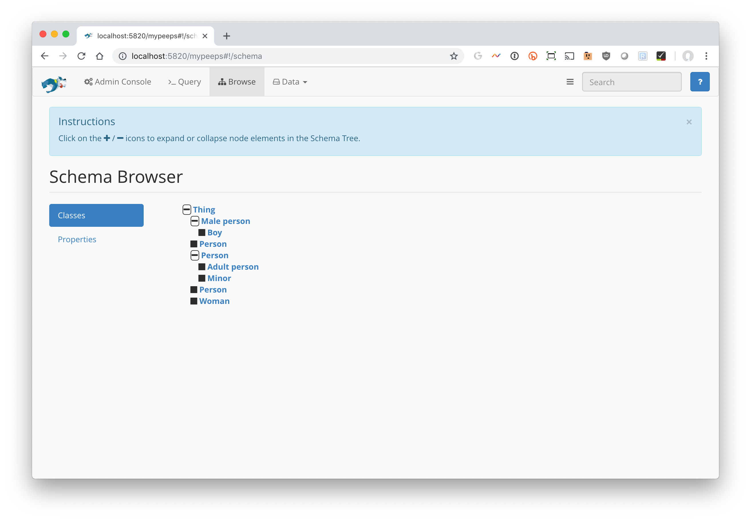
Go to Browse to explore the graph

Slide 24
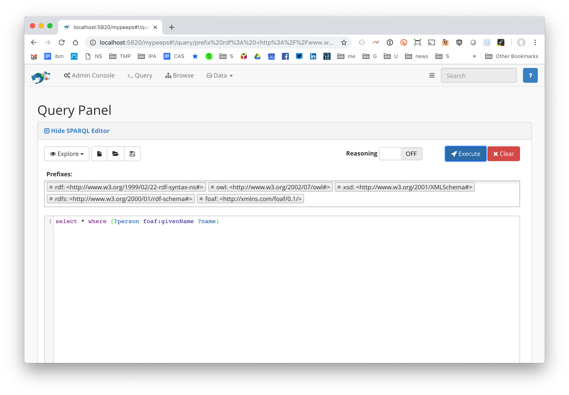
Go to Query to enter a SPARQL query
The query
select * where {?person foaf:givenName ?name}
Finds variable assignments that satisfy the where clause

Slide 25
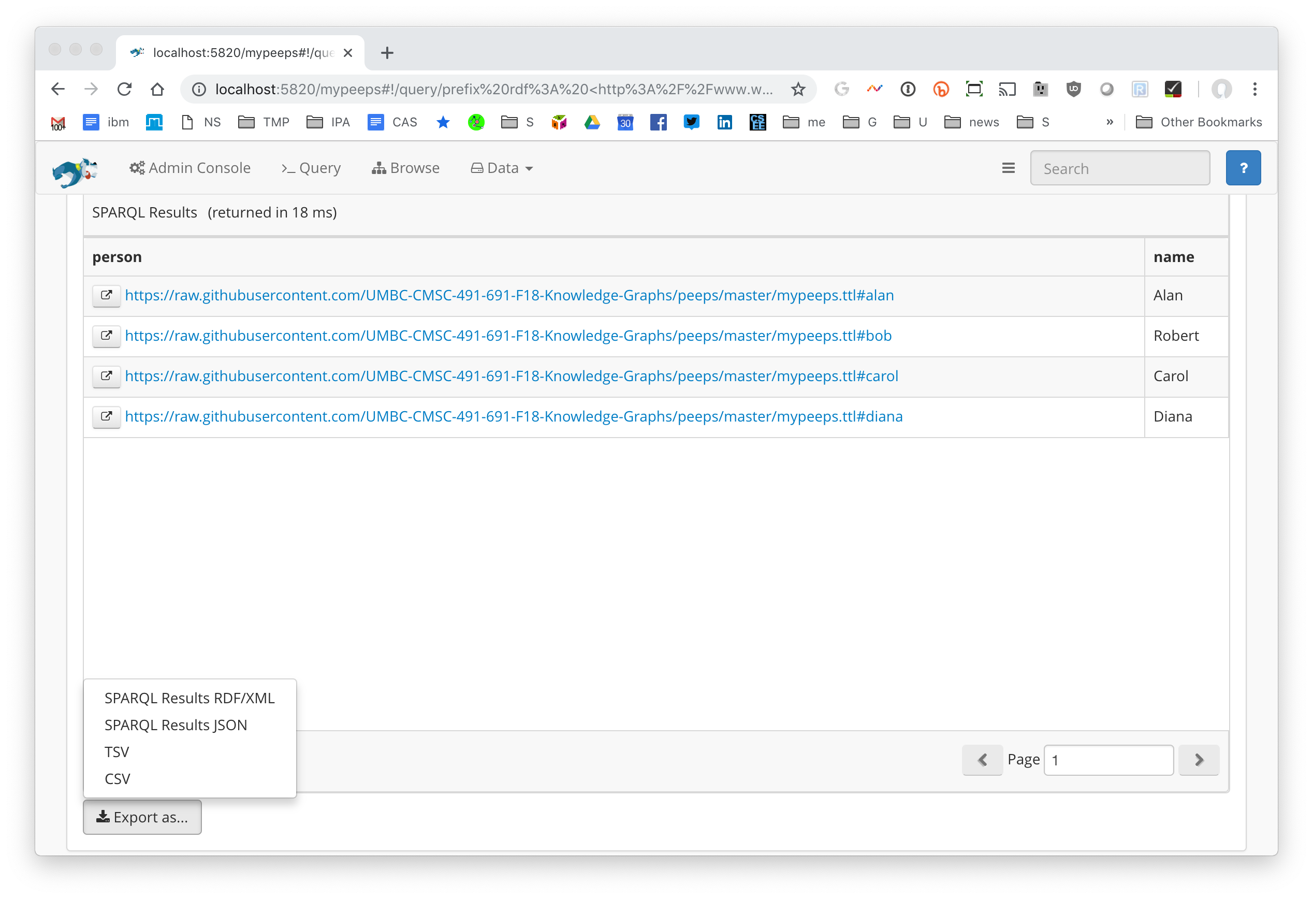
Go to Query to enter a SPARQL query
It found four solutions. The data can be exported to your computer as a file in any of several formats (e.g., rdf, json, csv, tsv)

Slide 26
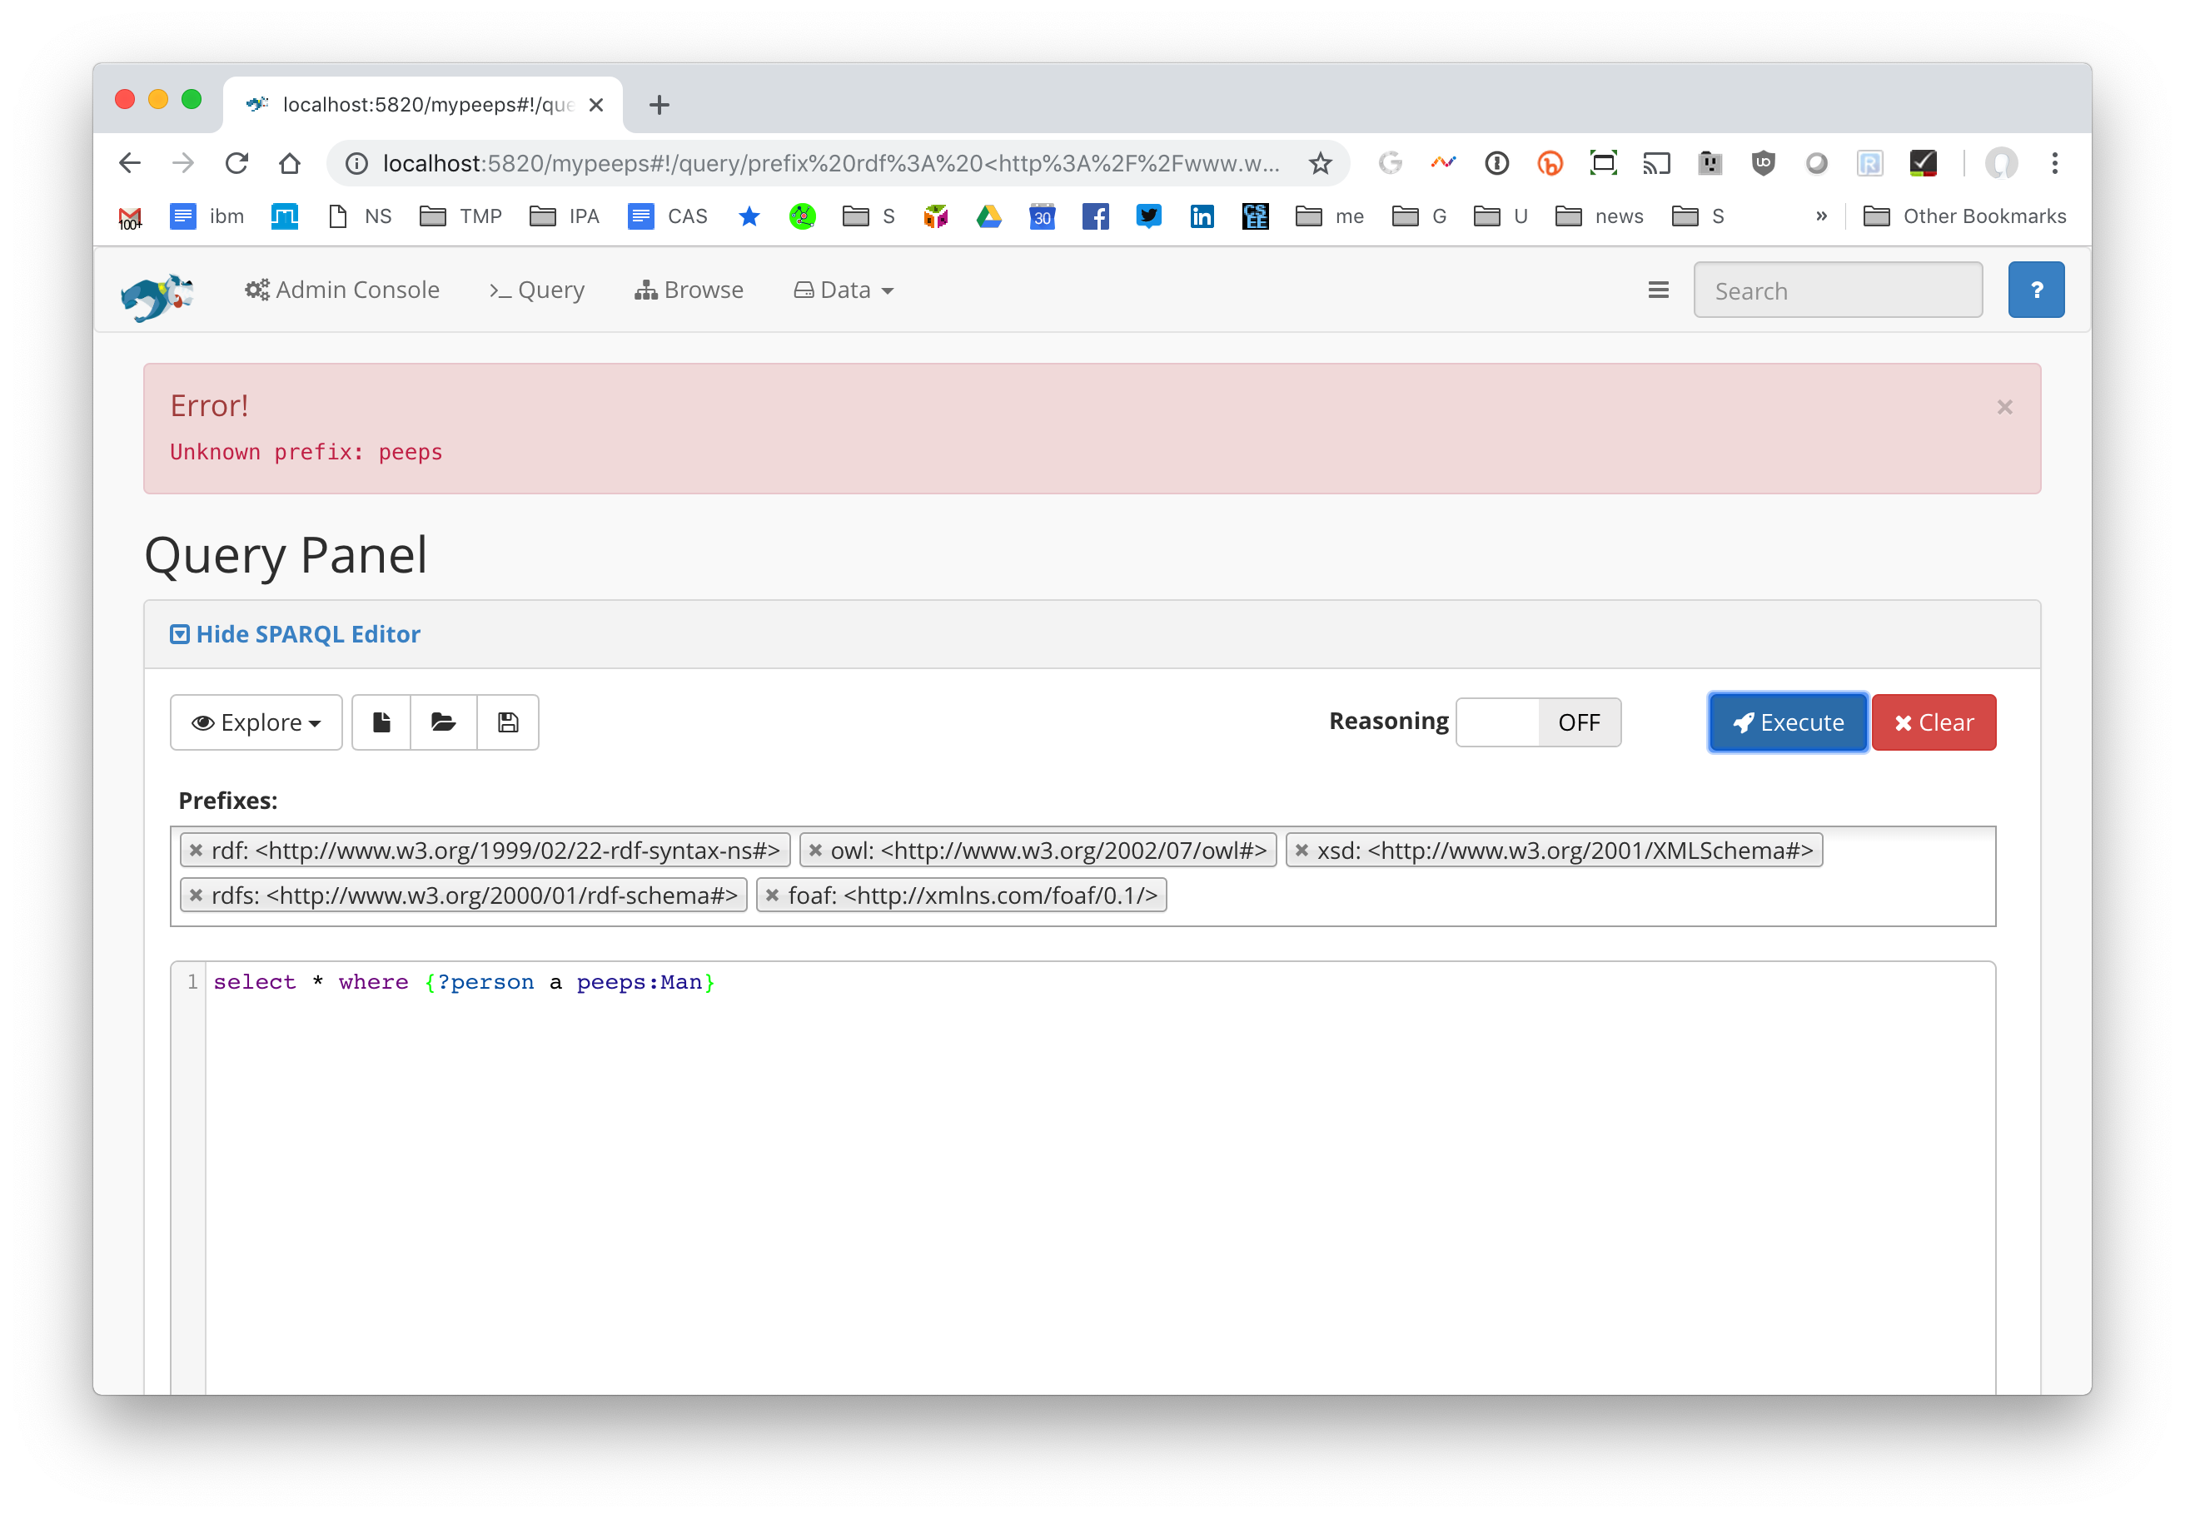
The query systems needs to know (independently) about any namespace prefixes you want to use (other than the common ones). Enter these when you create the database.

Slide 27
Command line commands
Running a simple bash script will create or refresh the peeps knowledge graph example
#!/bin/bash
# loads peeps.ttl, mypeeps.ttl and associated namespaces into a Stardog database.
PORT="5820"
SERVER="http://localhost:$PORT"
DBNAME="mypeeps"
DBURL="$SERVER/$DBNAME"
# stop server in case one is already running
stardog-admin --server $SERVER server stop
# start server
stardog-admin server start --port $PORT --disable-security
# drop database $DBNAME in case it exists already
stardog-admin --server $SERVER db drop -n $DBNAME
# create database $DBNAME with reasoning and search enabled
stardog-admin --server $SERVER db create -o reasoning.sameas=FULL -o search.enabled=true -n $DBNAME
# load ontology and data
stardog data add $DBURL peeps.ttl mypeeps.ttl
# add namespace prefixes for the query system to use
stardog namespace import --verbose $DBURL prefixes.ttl

Slide 28
Query from Python
Stardog serves as a endpoint for SPARQL queries
Use this URL to send queries to the mypeeps database
http://localhost:5820/mypeeps/query/
There are packages that help do this in many languages, including Python
See query.py in the peeps repository

